Slide 1
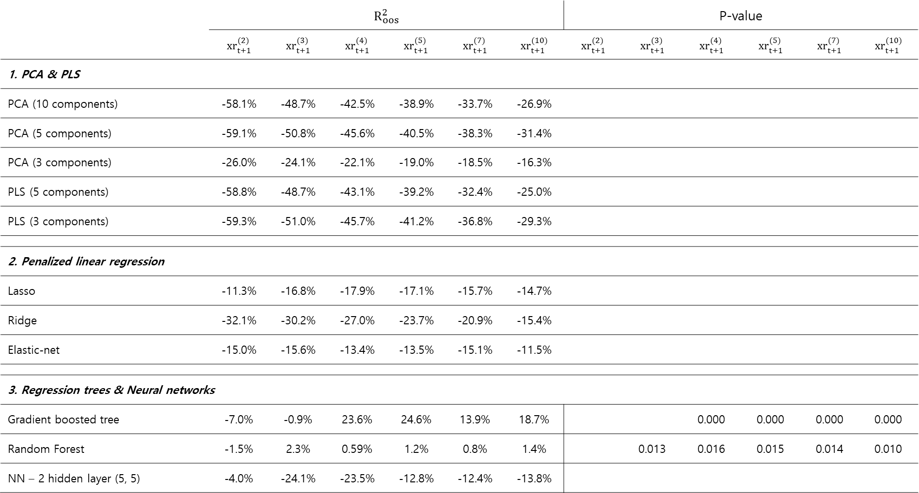
(**)
Table 1 Forecasting annual holding period returns with forward rates
 | $$R_{oos}^{2}$$ |  |  |  |  |  | P-value
 | $${xr}_{t+1}^{(2)}$$ | $${xr}_{t+1}^{(3)}$$ | $${xr}_{t+1}^{(4)}$$ | $${xr}_{t+1}^{(5)}$$ | $${xr}_{t+1}^{(7)}$$ | $${xr}_{t+1}^{(10)}$$ | $${xr}_{t+1}^{(2)}$$ | $${xr}_{t+1}^{(3)}$$ | $${xr}_{t+1}^{(4)}$$ | $${xr}_{t+1}^{(5)}$$ | $${xr}_{t+1}^{(7)}$$ | $${xr}_{t+1}^{(10)}$$
1. PCA & PLS
PCA (10 components) | -58.1% | -48.7% | -42.5% | -38.9% | -33.7% | -26.9%
PCA (5 components) | -59.1% | -50.8% | -45.6% | -40.5% | -38.3% | -31.4%
PCA (3 components) | -26.0% | -24.1% | -22.1% | -19.0% | -18.5% | -16.3%
PLS (5 components) | -58.8% | -48.7% | -43.1% | -39.2% | -32.4% | -25.0%
PLS (3 components) | -59.3% | -51.0% | -45.7% | -41.2% | -36.8% | -29.3%
2. Penalized linear regression
Lasso | -11.3% | -16.8% | -17.9% | -17.1% | -15.7% | -14.7%
Ridge | -32.1% | -30.2% | -27.0% | -23.7% | -20.9% | -15.4%
Elastic-net | -15.0% | -15.6% | -13.4% | -13.5% | -15.1% | -11.5%
3. Regression trees & Neural networks
Gradient boosted tree | -7.0% | -0.9% | 23.6% | 24.6% | 13.9% | 18.7% |  |  | 0.000 | 0.000 | 0.000 | 0.000
Random Forest | -1.5% | 2.3% | 0.59% | 1.2% | 0.8% | 1.4% |  | 0.013 | 0.016 | 0.015 | 0.014 | 0.010
NN – 2 hidden layer (5, 5) | -4.0% | -24.1% | -23.5% | -12.8% | -12.4% | -13.8%
(***)
(***)
(***)
(***)
(**)
(**)
(**)
(**)
(**)
$R_{oos}^{2}$ : Campbell and Tompson (2007)
P-value : Clark and West (2007), null hypothesis $R_{oos}^{2}≤0$,

Slide 2
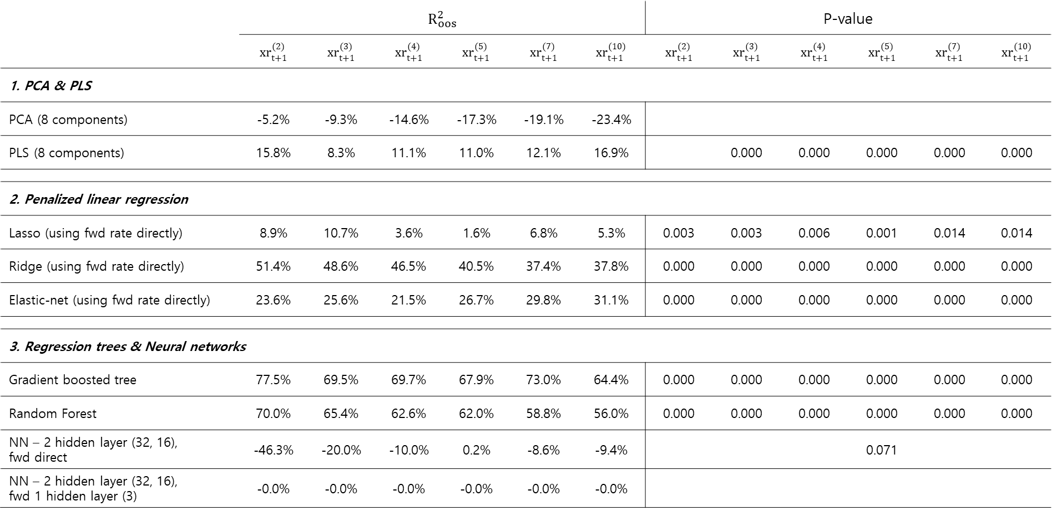
Table 2 Forecasting annual holding period returns with forward rates & macroeconomic variables
 | $$R_{oos}^{2}$$ |  |  |  |  |  | P-value
 | $${xr}_{t+1}^{(2)}$$ | $${xr}_{t+1}^{(3)}$$ | $${xr}_{t+1}^{(4)}$$ | $${xr}_{t+1}^{(5)}$$ | $${xr}_{t+1}^{(7)}$$ | $${xr}_{t+1}^{(10)}$$ | $${xr}_{t+1}^{(2)}$$ | $${xr}_{t+1}^{(3)}$$ | $${xr}_{t+1}^{(4)}$$ | $${xr}_{t+1}^{(5)}$$ | $${xr}_{t+1}^{(7)}$$ | $${xr}_{t+1}^{(10)}$$
1. PCA & PLS
PCA (8 components) | -5.2% | -9.3% | -14.6% | -17.3% | -19.1% | -23.4%
PLS (8 components) | 15.8% | 8.3% | 11.1% | 11.0% | 12.1% | 16.9% |  | 0.000 | 0.000 | 0.000 | 0.000 | 0.000
2. Penalized linear regression
Lasso (using fwd rate directly) | 8.9% | 10.7% | 3.6% | 1.6% | 6.8% | 5.3% | 0.003 | 0.003 | 0.006 | 0.001 | 0.014 | 0.014
Ridge (using fwd rate directly) | 51.4% | 48.6% | 46.5% | 40.5% | 37.4% | 37.8% | 0.000 | 0.000 | 0.000 | 0.000 | 0.000 | 0.000
Elastic-net (using fwd rate directly) | 23.6% | 25.6% | 21.5% | 26.7% | 29.8% | 31.1% | 0.000 | 0.000 | 0.000 | 0.000 | 0.000 | 0.000
3. Regression trees & Neural networks
Gradient boosted tree | 77.5% | 69.5% | 69.7% | 67.9% | 73.0% | 64.4% | 0.000 | 0.000 | 0.000 | 0.000 | 0.000 | 0.000
Random Forest | 70.0% | 65.4% | 62.6% | 62.0% | 58.8% | 56.0% | 0.000 | 0.000 | 0.000 | 0.000 | 0.000 | 0.000
NN – 2 hidden layer (32, 16), fwd direct | -46.3% | -20.0% | -10.0% | 0.2% | -8.6% | -9.4% |  |  |  | 0.071
NN – 2 hidden layer (32, 16), fwd 1 hidden layer (3) | -0.0% | -0.0% | -0.0% | -0.0% | -0.0% | -0.0%
(***)
(***)
(***)
(***)
(***)
(***)
(***)
(***)
(***)
(**)
(**)
(***)
(***)
(***)
(***)
(***)
(***)
(***)
(***)
(***)
(***)
(***)
(***)
(***)
(***)
(***)
(***)
(***)
(***)
(***)
(***)
(***)
(***)
(***)
(***)
(*)
$R_{oos}^{2}$ : Campbell and Tompson (2007)
P-value : Clark and West (2007), null hypothesis $R_{oos}^{2}≤0$,

Slide 3
Table 3 Pairwise tests of predictive accuracy (fwd rate only with fwd rate + macroeconomic variables)
 | PCA (8 components) | PLS (8 components) | Lasso | Ridge | Elastic-net | Gradient boosted tree | Random Forest | NN – 2 hidden layer (32, 16), fwd direct | NN – 2 hidden layer (32, 16), fwd 1 hidden layer (3)
PCA (3 components) | 0.525
PLS (3 components) |  | 0.049
Lasso |  |  | 0.0424
Ridge |  |  |  | 0.001
Elastic-net |  |  |  |  | 0.004
Gradient boosted tree |  |  |  |  |  | 0.000
Random Forest |  |  |  |  |  |  | 0.000
NN – 2 hidden layer (5, 5) |  |  |  |  |  |  |  | 0.12 | 0.84
(**)
(**)
(***)
(***)
(***)
(***)
Same Machine learning model, tests of predictive accuracy Forward rate only model with Forward & macro model
P-value : Diebold and Mariano(1995) extended by Harvey et al.(1997), (Null hypothesis : the pairs have the same performance)

Slide 4
Table 4 Pairwise tests of predictive accuracy (Forecast with fwd rates)
 | PCA (3 components | PLS (3 components) | Lasso | Ridge | Elastic-net | Gradient boosted tree | Random Forest | NN – 2 hidden layer (5, 5)
PCA (3 components) |  | 0.910 | 0.436 | 0.577 | 0.369 | 0.013 | 0.114 | 0.426
PLS (3 components) |  |  | 0.150 | 0.066 | 0.113 | 0.002 | 0.024 | 0.187
Lasso |  |  |  | 0.648 | 0.064 | 0.000 | 0.054 | 0.450
Ridge |  |  |  |  | 0.259 | 0.001 | 0.033 | 0.368
Elastic-net |  |  |  |  |  | 0.001 | 0.093 | 0.552
Gradient boosted tree |  |  |  |  |  |  | 0.993 | 0.995
Random Forest |  |  |  |  |  |  |  | 0.940
(**)
(*)
(***)
(**)
(*)
(***)
(*)
(***)
(**)
(***)
(*)
P-value : Diebold and Mariano(1995) extended by Harvey et al.(1997), (Null hypothesis : the pairs have the same performance)

Slide 5
Table 5 Pairwise tests of predictive accuracy (Forecast with fwd rates + macroeconomic variables)
 | PCA (8 components) | PLS (8 components) | Lasso | Ridge | Elastic-net | Gradient boosted tree | Random Forest | NN – 2 hidden layer (32, 16), fwd direct | NN – 2 hidden layer (32, 16), fwd 1 hidden l(3)
PCA (8 components) |  | 0.043 | 0.045 | 0.000 | 0.000 | 0.000 | 0.000 | 0.266 | 0.845
PLS (8 components) |  | ` | 0.648 | 0.032 | 0.218 | 0.007 | 0.021 | 0.826 | 0.845
Lasso |  |  |  | 0.007 | 0.001 | 0.000 | 0.000 | 0.945 | 0.845
Ridge |  |  |  |  | 0.844 | 0.004 | 0.030 | 0.999 | 0.845
Elastic-net |  |  |  |  |  | 0.000 | 0.006 | 0.999 | 0.845
Gradient boosted tree |  |  |  |  |  |  | 0.989 | 0.999 | 0.845
Random Forest |  |  |  |  |  |  |  | 0.999 | 0.845
NN – 2 hidden layer (32, 16), fwd direct |  |  |  |  |  |  |  |  | 0.845
(**)
(**)
(***)
(***)
(***)
(***)
(**)
(***)
(**)
(***)
(***)
(***)
(***)
(***)
(**)
(***)
(***)
P-value : Diebold and Mariano(1995) extended by Harvey et al.(1997), (Null hypothesis : the pairs have the same performance)

Slide 6


Slide 7
한쿡

Slide 8
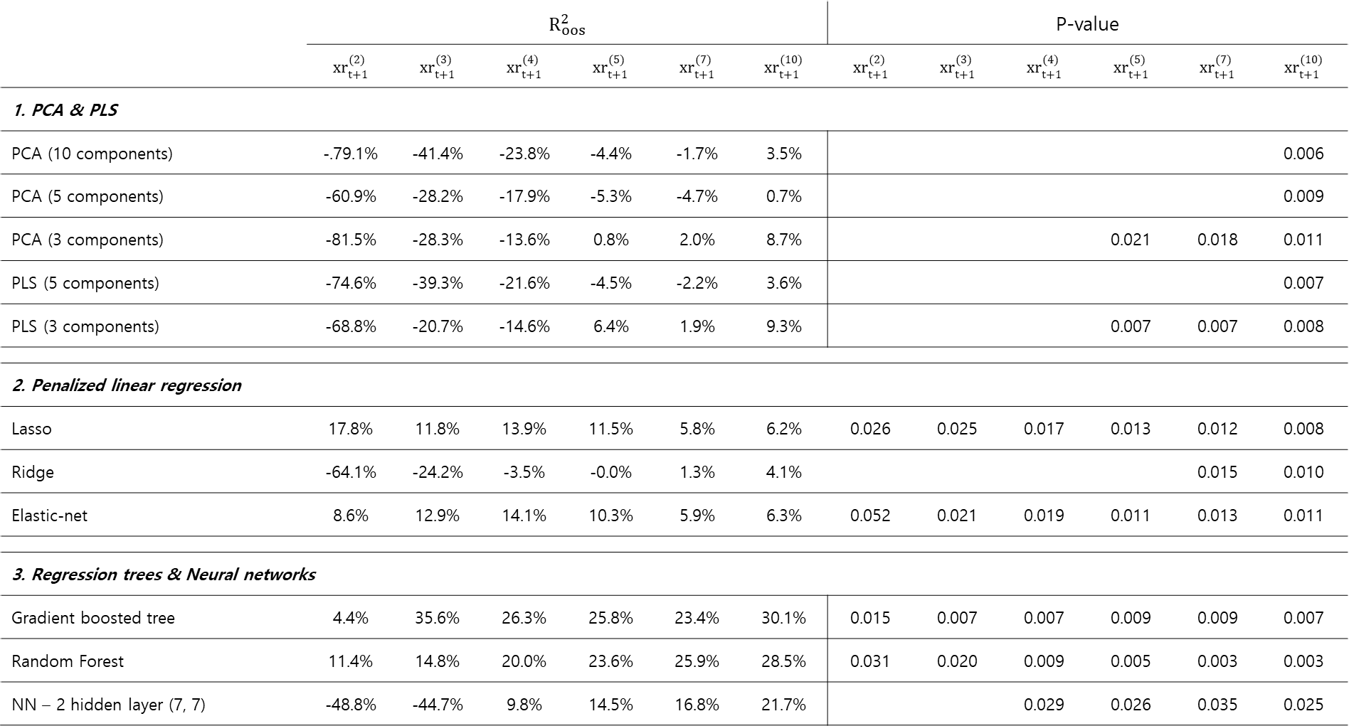
(**)
Table 1 Forecasting annual holding period returns with forward rates
 | $$R_{oos}^{2}$$ |  |  |  |  |  | P-value
 | $${xr}_{t+1}^{(2)}$$ | $${xr}_{t+1}^{(3)}$$ | $${xr}_{t+1}^{(4)}$$ | $${xr}_{t+1}^{(5)}$$ | $${xr}_{t+1}^{(7)}$$ | $${xr}_{t+1}^{(10)}$$ | $${xr}_{t+1}^{(2)}$$ | $${xr}_{t+1}^{(3)}$$ | $${xr}_{t+1}^{(4)}$$ | $${xr}_{t+1}^{(5)}$$ | $${xr}_{t+1}^{(7)}$$ | $${xr}_{t+1}^{(10)}$$
1. PCA & PLS
PCA (10 components) | -.79.1% | -41.4% | -23.8% | -4.4% | -1.7% | 3.5% |  |  |  |  |  | 0.006
PCA (5 components) | -60.9% | -28.2% | -17.9% | -5.3% | -4.7% | 0.7% |  |  |  |  |  | 0.009
PCA (3 components) | -81.5% | -28.3% | -13.6% | 0.8% | 2.0% | 8.7% |  |  |  | 0.021 | 0.018 | 0.011
PLS (5 components) | -74.6% | -39.3% | -21.6% | -4.5% | -2.2% | 3.6% |  |  |  |  |  | 0.007
PLS (3 components) | -68.8% | -20.7% | -14.6% | 6.4% | 1.9% | 9.3% |  |  |  | 0.007 | 0.007 | 0.008
2. Penalized linear regression
Lasso | 17.8% | 11.8% | 13.9% | 11.5% | 5.8% | 6.2% | 0.026 | 0.025 | 0.017 | 0.013 | 0.012 | 0.008
Ridge | -64.1% | -24.2% | -3.5% | -0.0% | 1.3% | 4.1% |  |  |  |  | 0.015 | 0.010
Elastic-net | 8.6% | 12.9% | 14.1% | 10.3% | 5.9% | 6.3% | 0.052 | 0.021 | 0.019 | 0.011 | 0.013 | 0.011
3. Regression trees & Neural networks
Gradient boosted tree | 4.4% | 35.6% | 26.3% | 25.8% | 23.4% | 30.1% | 0.015 | 0.007 | 0.007 | 0.009 | 0.009 | 0.007
Random Forest | 11.4% | 14.8% | 20.0% | 23.6% | 25.9% | 28.5% | 0.031 | 0.020 | 0.009 | 0.005 | 0.003 | 0.003
NN – 2 hidden layer (7, 7) | -48.8% | -44.7% | 9.8% | 14.5% | 16.8% | 21.7% |  |  | 0.029 | 0.026 | 0.035 | 0.025
(***)
(***)
(**)
(**)
(**)
(***)
(***)
(***)
(***)
(**)
(**)
(**)
(**)
(**)
(***)
(**)
(**)
(*)
(**)
(**)
(**)
(**)
(**)
(**)
(***)
(***)
(***)
(***)
(***)
(**)
(**)
(***)
(***)
(***)
(***)
(**)
(**)
(**)
(**)
$R_{oos}^{2}$ : Campbell and Tompson (2007)
P-value : Clark and West (2007), null hypothesis $R_{oos}^{2}≤0$,

Slide 9
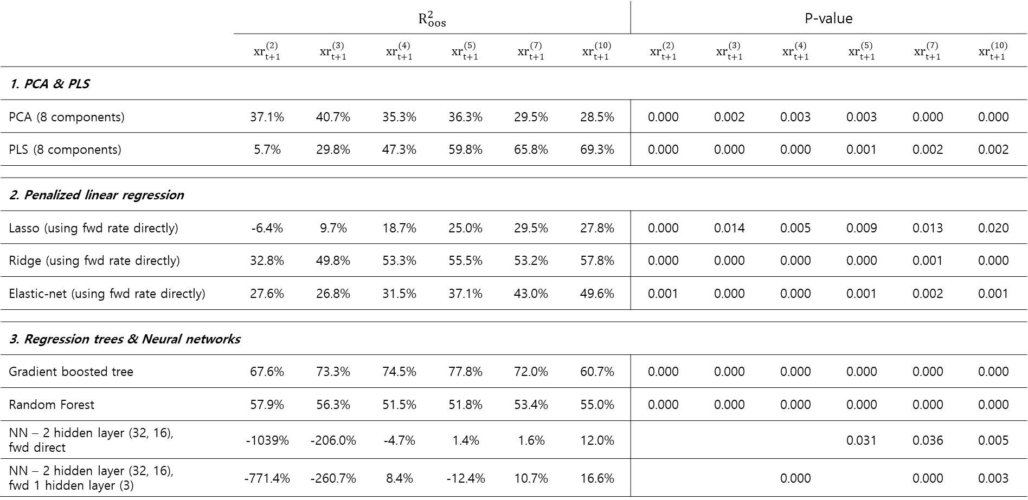
Table 2 Forecasting annual holding period returns with forward rates & macroeconomic variables
 | $$R_{oos}^{2}$$ |  |  |  |  |  | P-value
 | $${xr}_{t+1}^{(2)}$$ | $${xr}_{t+1}^{(3)}$$ | $${xr}_{t+1}^{(4)}$$ | $${xr}_{t+1}^{(5)}$$ | $${xr}_{t+1}^{(7)}$$ | $${xr}_{t+1}^{(10)}$$ | $${xr}_{t+1}^{(2)}$$ | $${xr}_{t+1}^{(3)}$$ | $${xr}_{t+1}^{(4)}$$ | $${xr}_{t+1}^{(5)}$$ | $${xr}_{t+1}^{(7)}$$ | $${xr}_{t+1}^{(10)}$$
1. PCA & PLS
PCA (8 components) | 37.1% | 40.7% | 35.3% | 36.3% | 29.5% | 28.5% | 0.000 | 0.002 | 0.003 | 0.003 | 0.000 | 0.000
PLS (8 components) | 5.7% | 29.8% | 47.3% | 59.8% | 65.8% | 69.3% | 0.000 | 0.000 | 0.000 | 0.001 | 0.002 | 0.002
2. Penalized linear regression
Lasso (using fwd rate directly) | -6.4% | 9.7% | 18.7% | 25.0% | 29.5% | 27.8% | 0.000 | 0.014 | 0.005 | 0.009 | 0.013 | 0.020
Ridge (using fwd rate directly) | 32.8% | 49.8% | 53.3% | 55.5% | 53.2% | 57.8% | 0.000 | 0.000 | 0.000 | 0.000 | 0.001 | 0.000
Elastic-net (using fwd rate directly) | 27.6% | 26.8% | 31.5% | 37.1% | 43.0% | 49.6% | 0.001 | 0.000 | 0.000 | 0.001 | 0.002 | 0.001
3. Regression trees & Neural networks
Gradient boosted tree | 67.6% | 73.3% | 74.5% | 77.8% | 72.0% | 60.7% | 0.000 | 0.000 | 0.000 | 0.000 | 0.000 | 0.000
Random Forest | 57.9% | 56.3% | 51.5% | 51.8% | 53.4% | 55.0% | 0.000 | 0.000 | 0.000 | 0.000 | 0.000 | 0.000
NN – 2 hidden layer (32, 16), fwd direct | -1039% | -206.0% | -4.7% | 1.4% | 1.6% | 12.0% |  |  |  | 0.031 | 0.036 | 0.005
NN – 2 hidden layer (32, 16), fwd 1 hidden layer (3) | -771.4% | -260.7% | 8.4% | -12.4% | 10.7% | 16.6% |  |  | 0.000 |  | 0.000 | 0.003
(***)
(***)
(***)
(***)
(***)
(***)
(***)
(***)
(***)
(***)
(***)
(***)
(**)
(***)
(***)
(**)
(***)
(***)
(***)
(***)
(***)
(***)
(***)
(***)
(***)
(***)
(***)
(***)
(***)
(***)
(***)
(***)
(***)
(***)
(***)
(***)
(***)
(***)
(***)
(***)
(**)
(**)
(***)
(***)
(***)
(***)
$R_{oos}^{2}$ : Campbell and Tompson (2007)
P-value : Clark and West (2007), null hypothesis $R_{oos}^{2}≤0$,

Slide 10
Table 3 Pairwise tests of predictive accuracy (fwd rate only with fwd rate + macroeconomic variables)
 | PCA (8 components) | PLS (8 components) | Lasso | Ridge | Elastic-net | Gradient boosted tree | Random Forest | NN – 2 hidden layer (32, 16), fwd direct | NN – 2 hidden layer (32, 16), fwd 1 hidden layer (3)
PCA (3 components) | 0.085
PLS (3 components) |  | 0.004
Lasso |  |  | 0.034
Ridge |  |  |  | 0.002
Elastic-net |  |  |  |  | 0.004
Gradient boosted tree |  |  |  |  |  | 0.008
Random Forest |  |  |  |  |  |  | 0.001
NN – 2 hidden layer (5, 5) |  |  |  |  |  |  |  | 0.93 | 0.74
(*)
(***)
(**)
(***)
(***)
(***)
(***)
Same Machine learning model, tests of predictive accuracy Forward rate only model with Forward & macro model
P-value : Diebold and Mariano(1995) extended by Harvey et al.(1997), (Null hypothesis : the pairs have the same performance)

Slide 11
Table 4 Pairwise tests of predictive accuracy (Forecast with fwd rates)
 | PCA (3 components | PLS (3 components) | Lasso | Ridge | Elastic-net | Gradient boosted tree | Random Forest | NN – 2 hidden layer (5, 5)
PCA (3 components) |  | 0.445 | 0.414 | 0.628 | 0.408 | 0.115 | 0.072 | 0.028
PLS (3 components) |  |  | 0.419 | 0.876 | 0.415 | 0.154 | 0.099 | 0.107
Lasso |  |  |  | 0.710 | 0.519 | 0.186 | 0.161 | 0.182
Ridge |  |  |  |  | 0.270 | 0.133 | 0.087 | 0.042
Elastic-net |  |  |  |  |  | 0.183 | 0.155 | 0.156
Gradient boosted tree |  |  |  |  |  |  | 0.546 | 0.693
Random Forest |  |  |  |  |  |  |  | 0.705
(*)
(**)
(*)
(*)
P-value : Diebold and Mariano(1995) extended by Harvey et al.(1997), (Null hypothesis : the pairs have the same performance)

Slide 12
Table 5 Pairwise tests of predictive accuracy (Forecast with fwd rates + macroeconomic variables)
 | PCA (8 components) | PLS (8 components) | Lasso | Ridge | Elastic-net | Gradient boosted tree | Random Forest | NN – 2 hidden layer (32, 16), fwd direct | NN – 2 hidden layer (32, 16), fwd 1 hidden l(3)
PCA (8 components) |  | 0.026 | 0.588 | 0.014 | 0.105 | 0.059 | 0.084 | 0.966 | 0.984
PLS (8 components) |  |  | 0.998 | 0.898 | 0.988 | 0.485 | 0.845 | 0.999 | 0.999
Lasso |  |  |  | 0.000 | 0.018 | 0.008 | 0.008 | 0.995 | 0.954
Ridge |  |  |  |  | 0.998 | 0.253 | 0.565 | 0.999 | 0.999
Elastic-net |  |  |  |  |  | 0.072 | 0.208 | 0.997 | 0.999
Gradient boosted tree |  |  |  |  |  |  | 0.925 | 0.997 | 0.997
Random Forest |  |  |  |  |  |  |  | 0.998 | 0.998
NN – 2 hidden layer (32, 16), fwd direct |  |  |  |  |  |  |  |  | 0.396
(**)
(**)
(*)
(*)
(***)
(**)
(***)
(***)
(*)
P-value : Diebold and Mariano(1995) extended by Harvey et al.(1997), (Null hypothesis : the pairs have the same performance)

